Slide 1

SWITCHING THEORY AND LOGIC DESIGN
Lecture-1
UNIT-v
Sequential Circuits-II
P.Archana,
BE(ECE), MTECH(ECE)
ASSIST.PROF
Dept of ECE

Slide 2
Review of Unit-4 : Sequential Circuits-I
Classification of sequential circuits (Synchronous, Asynchronous Pulse mode, and Level mode with examples)
Basic flip-flops-Triggering and excitation tables.
Conversions of flip flops.

Slide 3
Unit-5: Sequential Circuits-II
The sequential circuit model.
Asynchronous counters
Design of simple synchronous sequential circuits such as counters.
Design of modulo-N counter, Ring counter, twisted ring counter.
Shift registers
Applications: Design of 1010 sequence detector

Slide 4
Counters
A Digital counter is a set of flip-flops whose states change in response to pulses applied at the input to the counter.
The FFs are interconnected such that their combined state at any time is the binary equivalent of the total number of pulses that have occurred up to that time.
A counter can also be used as a frequency divider to obtain waveforms with frequencies that are specific fractions of the clock frequency.
Applications: perform timing function as in digital watches, to create time delays, to produce non-sequential binary counts, to generate pulse trains.

Slide 5
Classification of Counters
Counters are of two types
Asynchronous counters(Ripple counters):
The FFs are not made to change the states at exactly the same time.
The asynchronous counter is called ripple counter because the transition of the first stage ripples through to the last stage.
This are also called as serial or series counters counters
Synchronous counters:
Synchronous counters are clocked such that each FF in the counter is triggered at the same time.

Slide 6
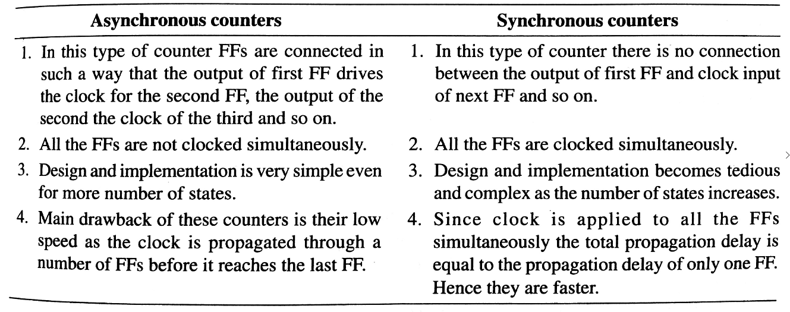
Asynchronous vs Synchronous Conters

Slide 7
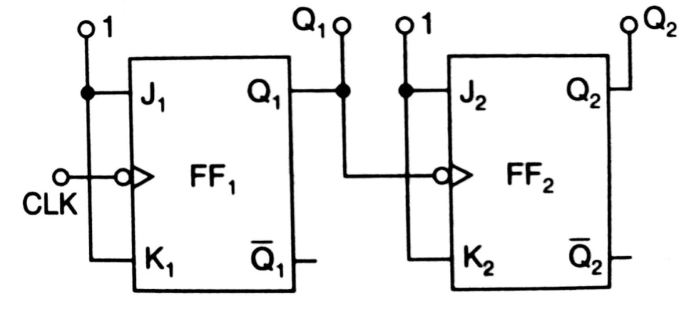
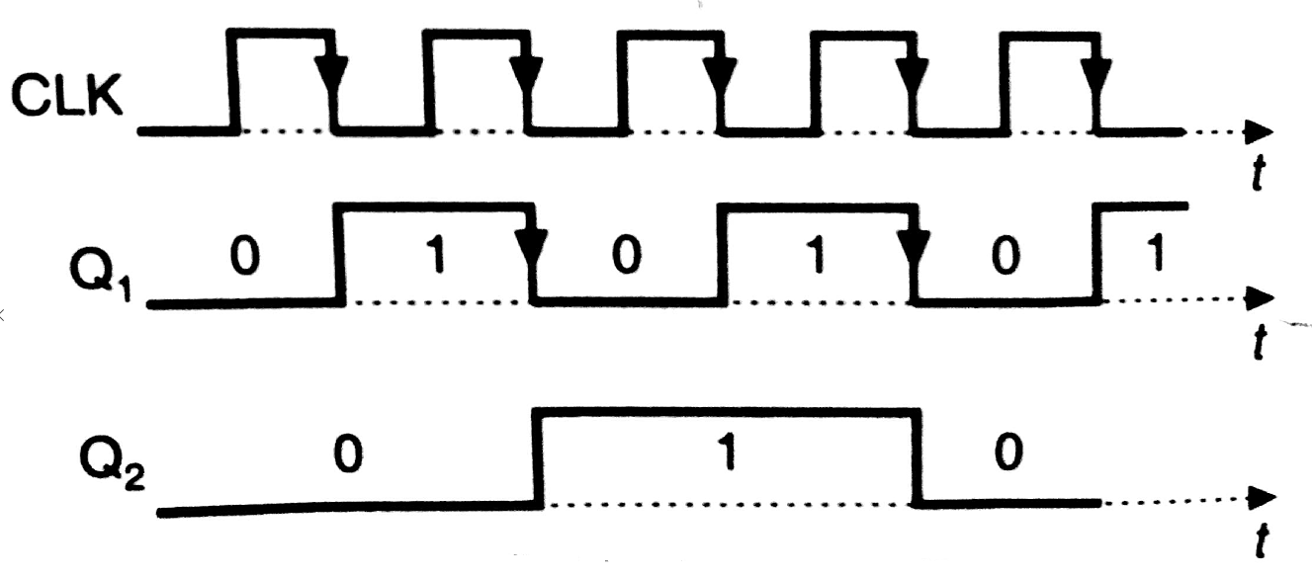
2-bit Ripple up Counter
The 2-bit up-counter counts in the order 0,1, 2, 3, 0, 1, …. i.e 00,01,10,11,00,01….etc.
(a) Logic Diagram
(a) Timing Diagram

Slide 8
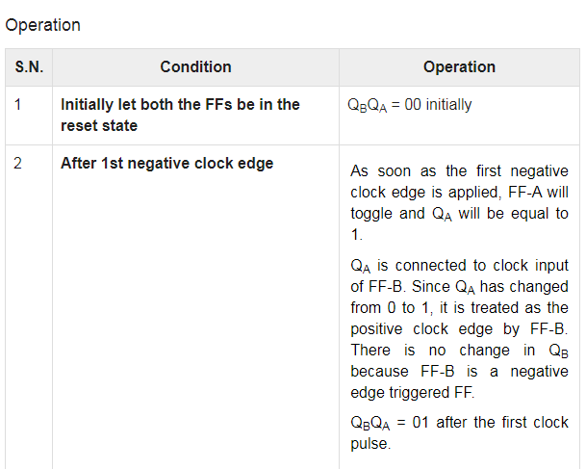
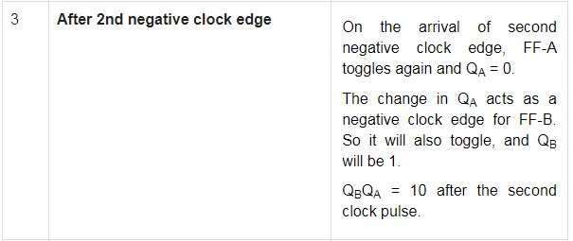

Slide 9
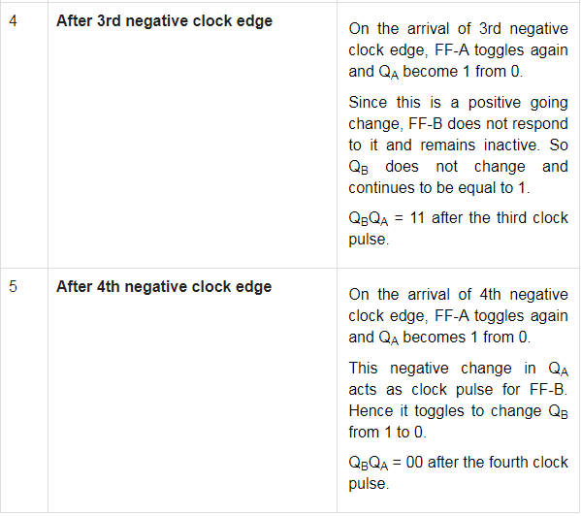

Slide 10
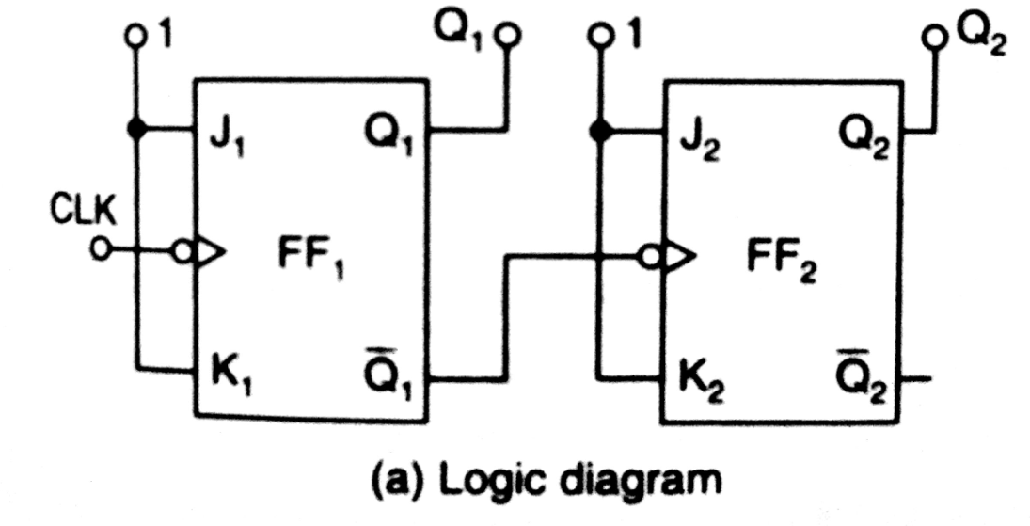
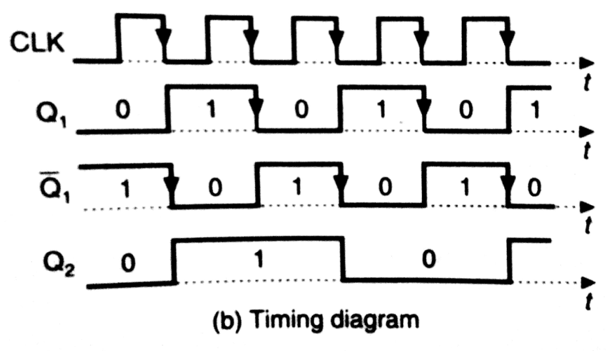
2-Bit Ripple Down Counter
The 2-bit up-counter counts in the order 0,1, 2, 3, 0, 1, …. i.e 00,01,10,11,00,01….etc.

Slide 11
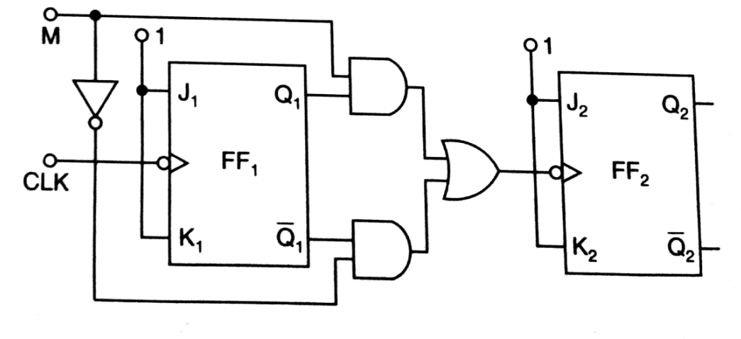
2-Bit Ripple up/down Counter
Mode Signal “M” is required to chose direction of count.
When M=1 , Q1 transmitted to clock of FF2 so it acts like a up counter.
When M=0 , Q1’ transmitted to clock of FF2 so it acts like a down counter

Slide 12
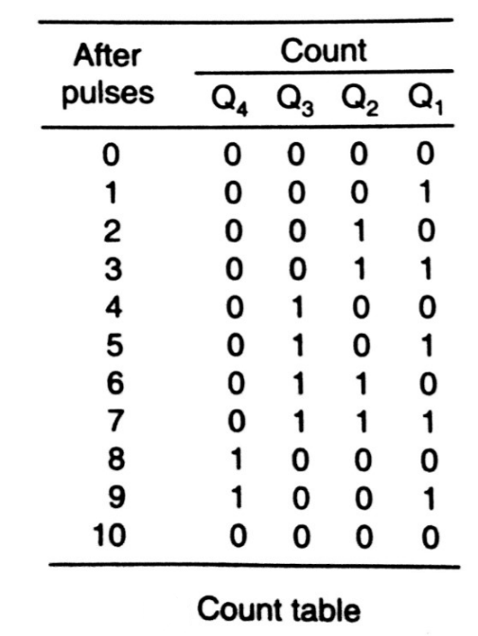
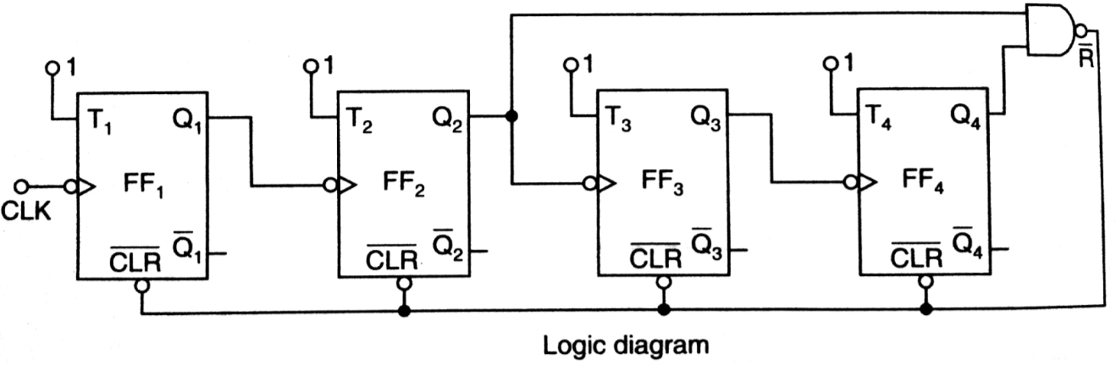
Mod-10 Asynchronous Counter using T FFS
A Mod-10 counter is a decade counter. It is also called a BCD counter or divide-by-10 counter.
It requires four FFs (the smallest value of “n” satisfying the condition 10 ≤ 2^{n} is n=4). So there are 16 possible states ,out of which 10 are valid and remaining 6 are invalid.

Slide 13
Synchronous Counter
Design of Synchronous Counters.
Number of flip-flops: Based on the description of the problem
State Diagram: Draw the state diagram showing all the possible states.
Choice of flip-flops and excitation table: Select the type of flip-flops to be used and write the excitation table.
Minimal expressions for excitations: Obtain the Minimal expressions for the excitations of FFs using K-Map
Logic Diagram: Draw the logic diagram based on the minimal expressions.

Slide 14
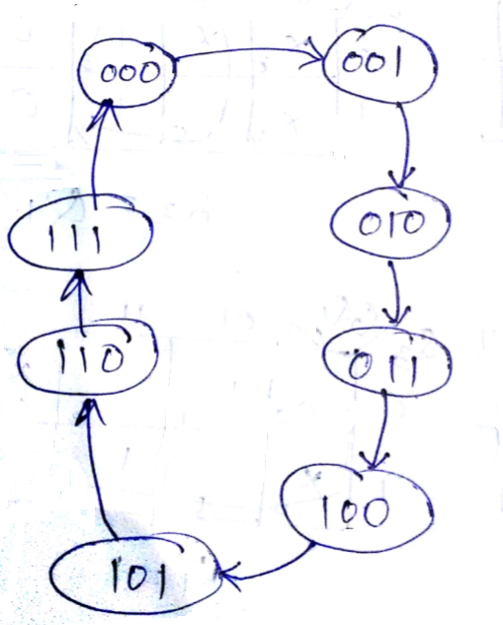
Synchronous 3-Bit up counter using J-K FF
Step1: Determine number of Flip-Flops required: A 3-Bit counter requires three FFS.
Step2: Draw the state diagram

Slide 15
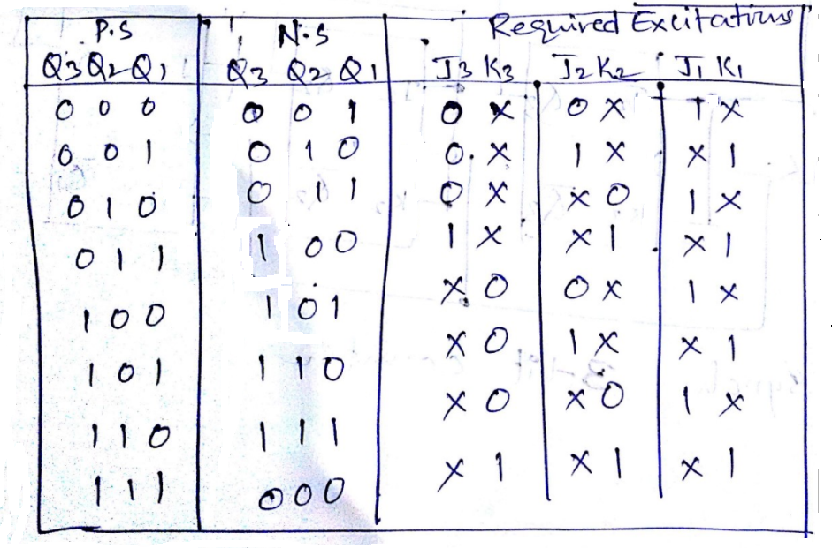
Step3: Select the type of flip-flops and draw the excitation table.

Slide 16
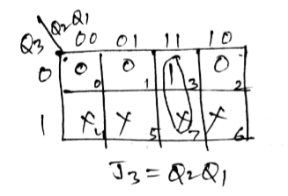
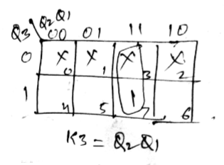
Step4: obtain the minimal expressions using k-map.

Slide 17
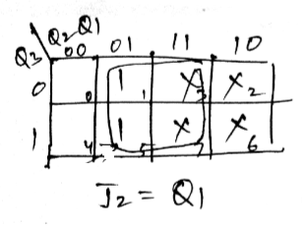
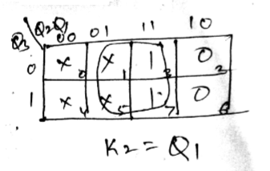
Step4: obtain the minimal expressions using k-map.

Slide 18
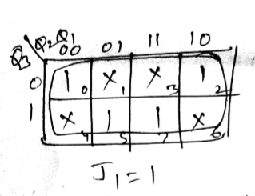
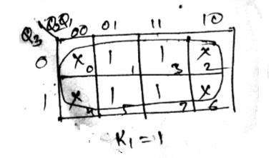
Step4: obtain the minimal expressions using k-map.

Slide 19
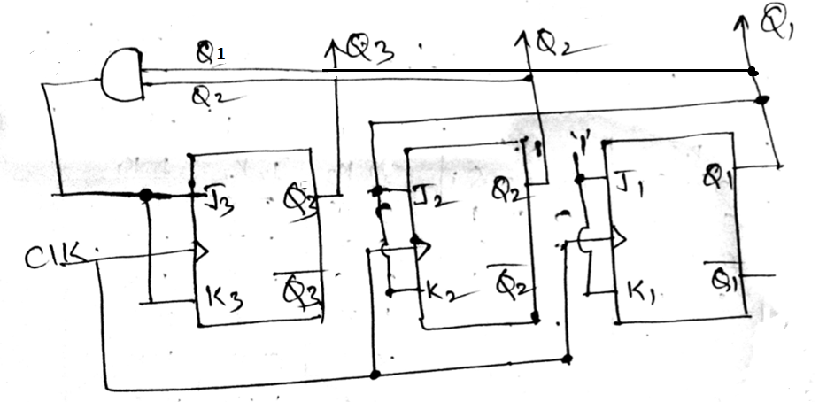
Step5: Draw the logic diagram.
J1= 1 K1= 1
J2= Q1 K2= Q1
J3= Q1 Q2 K3= Q1 Q2

Slide 20
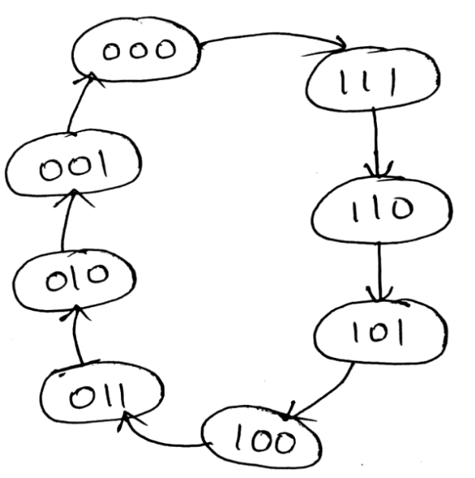
Synchronous 3-bit down counter using T-FF
Step1: Determine number of Flip-Flops required: A 3-Bit counter requires three FFS
Step2: Draw the state diagram

Slide 21
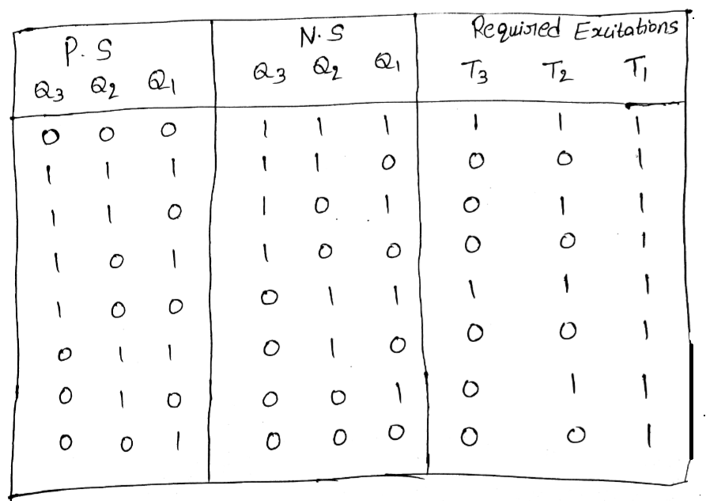
Step3: Select the type of flip-flops and draw the excitation table.

Slide 22
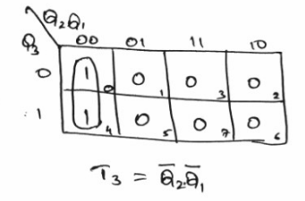
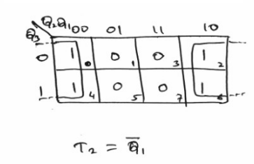
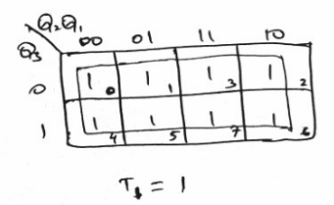
Step4: obtain the minimal expressions using k-map.

Slide 23
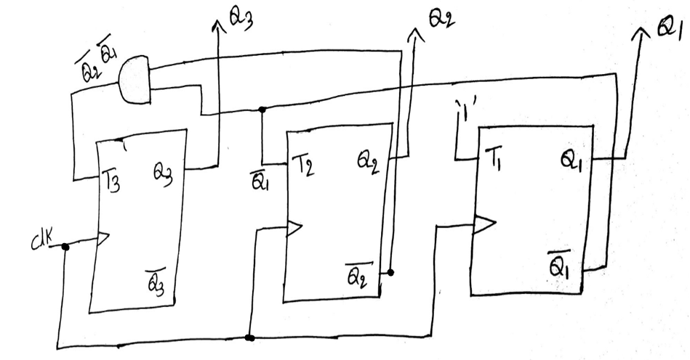
Step5: Draw the logic diagram.

Slide 24
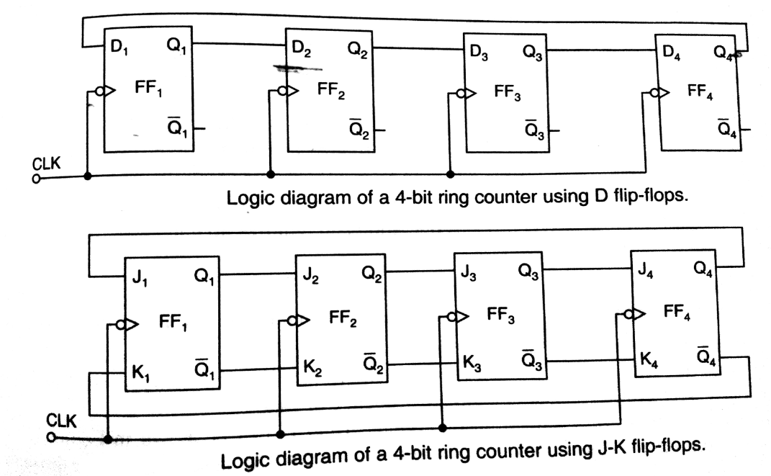
Ring Counter
The Q output of each stage is connected to the D input of next stage , but the Q output of last FF is connected back to the D input of the first FF such that the array of FFs is arranged in a ring therefore the name ring counter.

Slide 25
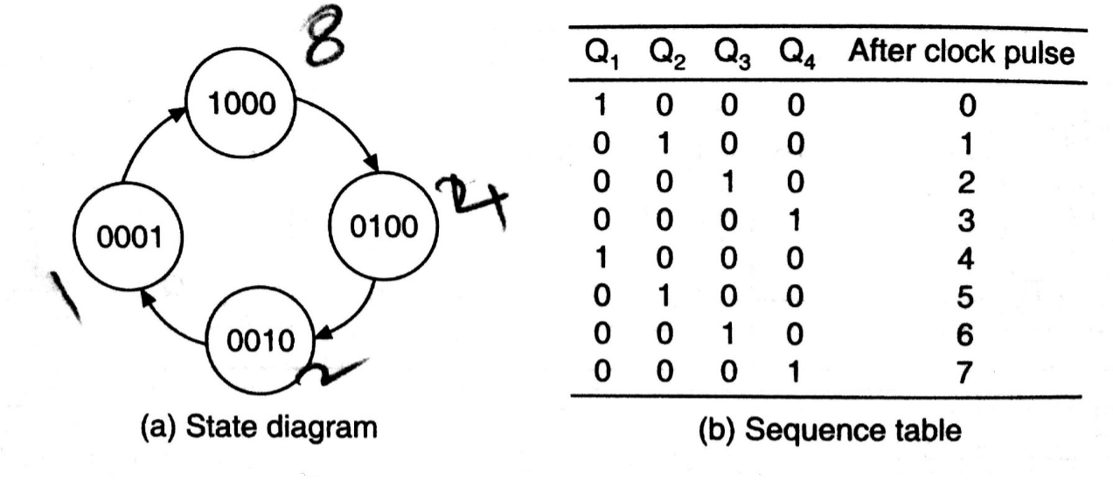
Only single 1 is in the register and is made to circulate around the register as long as clock pulses are applied.
The number of distinct states in the ring counter i.e the mod of the ring counter is equal to the number of FFs used in the counter
An n-bit ring counter can count only n-clock pulses, where as an ripple counter can count 2^{n} clock pulses.

Slide 26
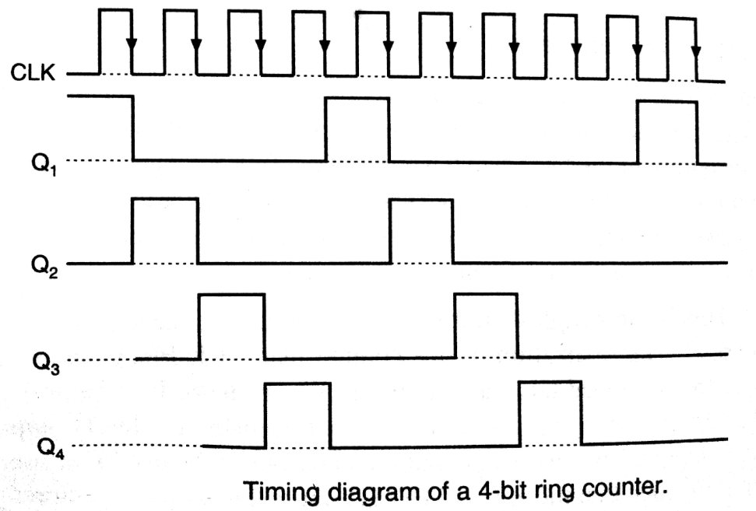

Slide 27
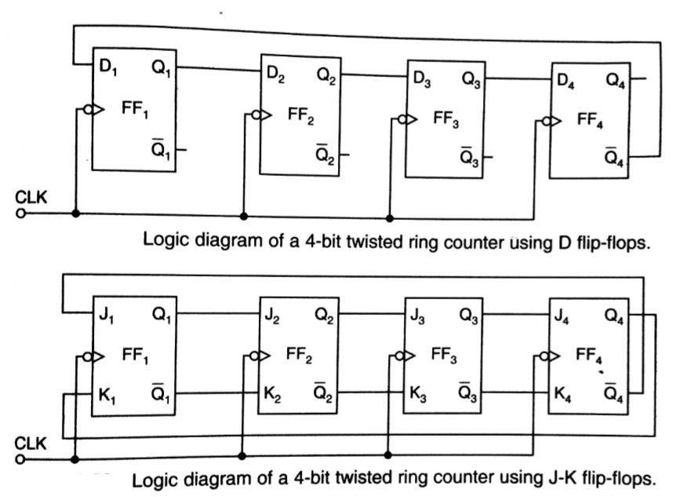
Twisted Ring Counter (Johnson Counter)
The counter is obtained by providing feedback from the inverted output of the last FF to the D input of the first FF. The Q output of each stage is connected to the D input of the next stage.

Slide 28
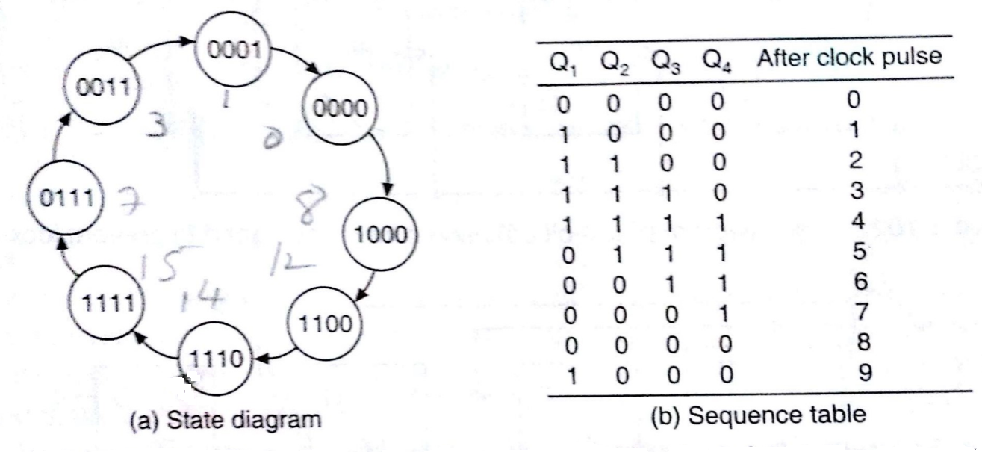
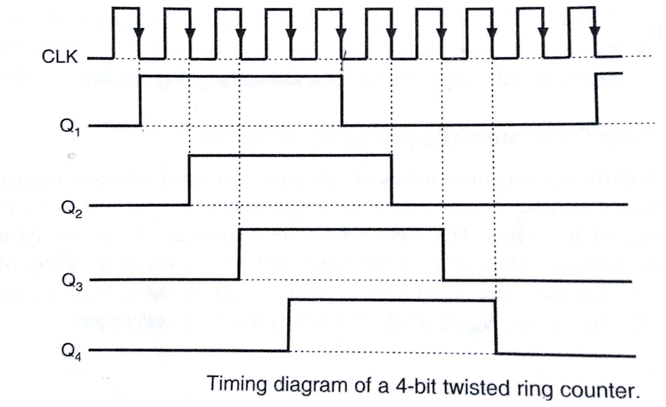

Slide 29
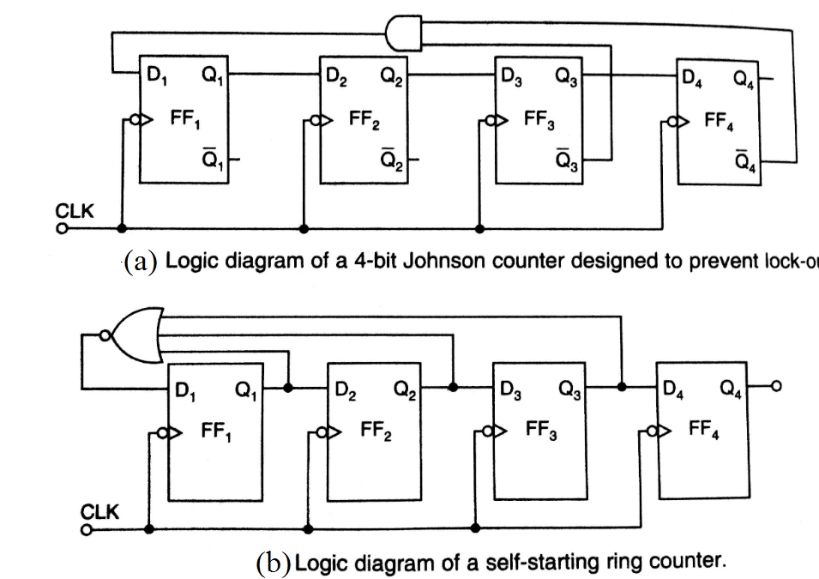
Draw backs of Ring counters
Both types of ring counters suffer from probem of Lock-out i.e if the counter finds itself in an unused state .it will persist in moving from one unused state to another and will never find its way to a used state.

